Slide 1


Slide 2

Customer Satisfaction
Is Our Highest Priority

Slide 3


Slide 4
In this session
Achieved
What we are learning in this session
Introduction
Classes and Objects
Encapsulation
Inheritance
Polymorphism
Abstraction
Advanced Inheritance and Polymorphism
SOLID principles
www.bacancytechnology.com

Slide 5
Let’s Start

Slide 6
Introduction
Achieved
Object-oriented programming (OOP) is a way of developing software applications using real-world terminologies to create entities that interact with one another using objects.
OOP makes applications flexible, reusable, well-structured, and easy to debug and test.
The basic building blocks of OOP are classes, methods, properties, and objects.
Classes define the structure of an object, methods represent the behavior of an object, properties hold the data of an object, and objects are instances of a class.
Here are some of the benefits of OOP:
Reusability: Object-oriented programming (OOP) introduces Classes and Objects to promote code reuse. Instead of repeating the same code, you can create a class once and use its object multiple times wherever needed.
www.bacancytechnology.com

Slide 7
Introduction
Achieved
Extensibility: OOP allows you to add new features without rewriting everything. Using concepts like Inheritance you can extend existing code easily.
Simplicity: Unlike traditional modular programming, where code can be scattered and harder to secure, OOP organizes code using Abstraction, Encapsulation, and Polymorphism. This simplifies understanding and enhances security.
Maintainability: Since OOP focuses on Reusability, Extensibility, and Simplicity, it results in clean, organized, and easy-to-maintain code. This improves the overall quality and lifespan of applications.
www.bacancytechnology.com

Slide 8
Classes and Objects
Achieved
Class : A class is a user-defined blueprint that defines both state (properties) and behavior (actions). It serves as a template for creating objects. In C#, a class consists of a name, attributes (properties), and operations (methods).
Object: An object is a specific instance of a class. It brings the class to life and performs actions defined by the class. To access a class's members (attributes and methods), you use an object along with the dot(.) Operator.
Methods: A method represents a particular behavior. It performs some action and might return information about an object, or update an object’s data.
Properties: Properties hold the data temporarily during the execution of an application.
www.bacancytechnology.com

Slide 9
Classes and Objects
Achieved
Ex:
public class Calculator
{
public int CalculateSum(int no1, int no2)
{
return no1 + no2;
}
}
//Creating object
Calculator calObject = new Calculator();
//Accessing Calculator class member using Calculator class object
int result = calObject.CalculateSum(10, 20);
www.bacancytechnology.com

Slide 10
Constructors and Destructors
Achieved
Consructor: It is a special method present inside a class responsible for initializing the variables of that class.
Destructor: A destructor is a special method that is called automatically when an object is destroyed or goes out of scope. It is used to release resources. In C#, a destructor has the same name as the class but is preceded by a tilde (~).
www.bacancytechnology.com

Slide 11
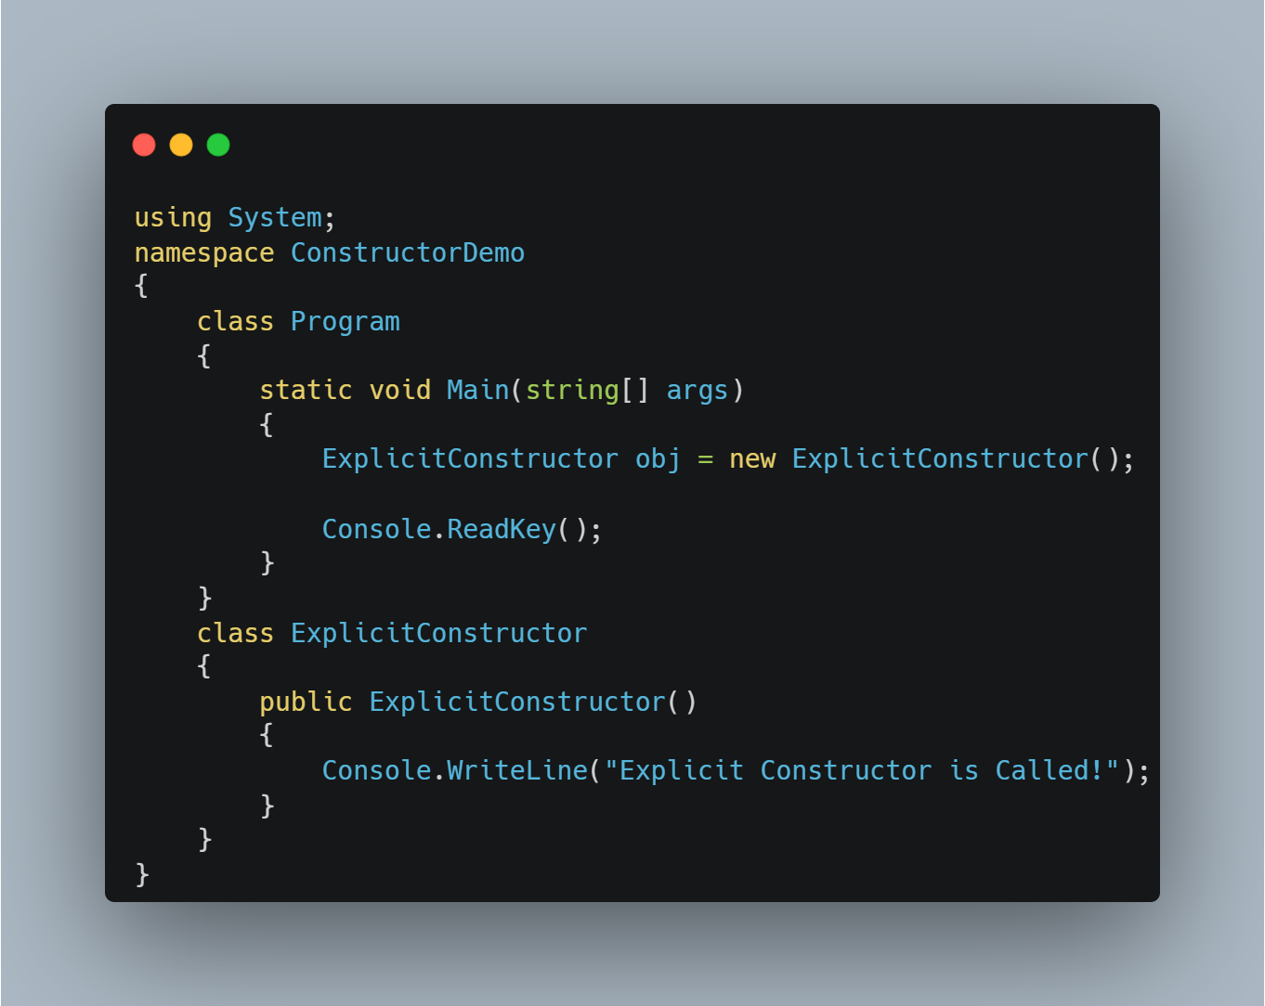
Constructors and Destructors
Achieved
www.bacancytechnology.com

Slide 12
Access Modifiers
Achieved
Modifier | Accessibility
Public | Accessible from anywhere in the application.
Private | Accessible only within the class where it is defined.
Protected | Accessible within the class and by derived classes.
Internal | Accessible within the same assembly (project).
Protected Internal | Accessible within the same assembly or by derived classes.
Private Protected | Accessible within the same class and derived classes, but only in the same assembly.
www.bacancytechnology.com

Slide 13
Encapsulation
Achieved
Property: Properties hold the data temporarily during the execution of an application.
Fields : Fields are variables that directly hold data in a class. Typically kept private to restrict direct access and ensure better control.
Accessors : An accessor is a special block of code in a property that is used to get (retrieve) or set (assign) the value of a private field in a controlled way. Get Accessor : The get accessor is used to retrieve the value of a private field. Set Accessor : The set accessor is used to assign a value to a private field.
www.bacancytechnology.com

Slide 14
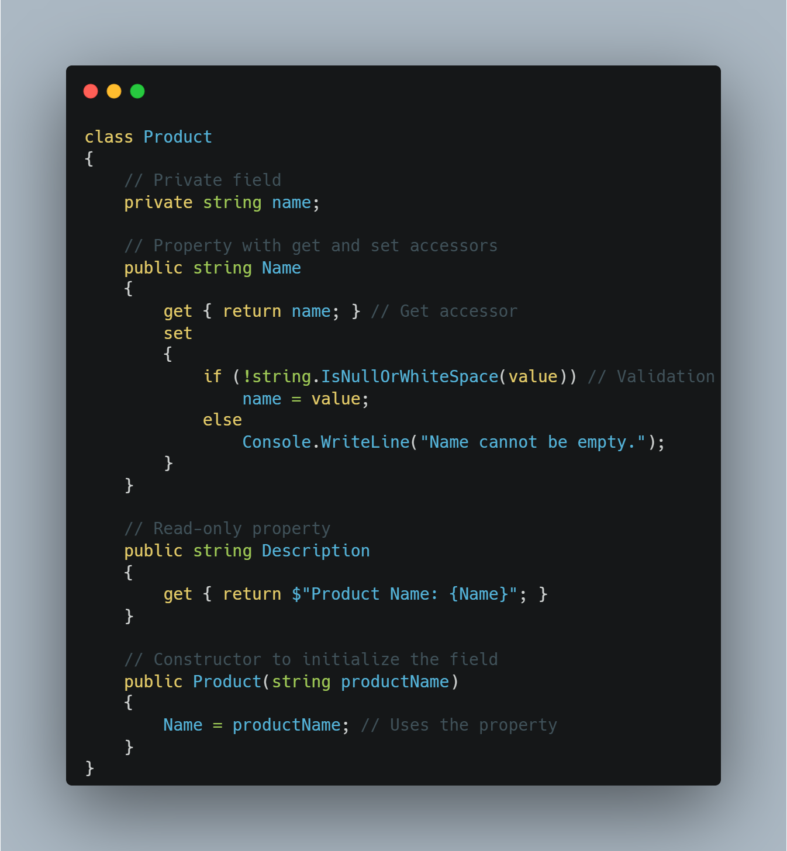
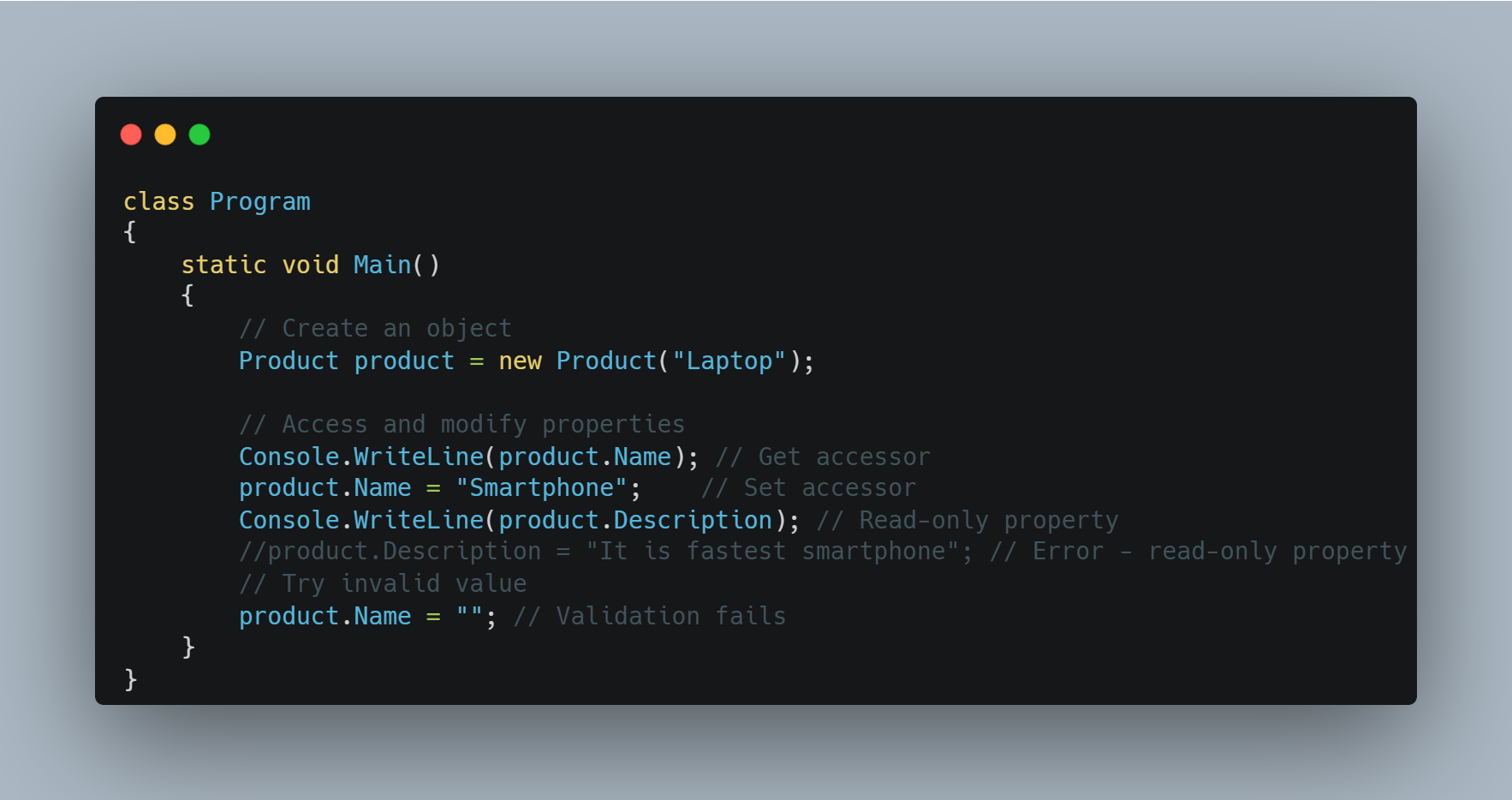
Encapsulation
Achieved
www.bacancytechnology.com

Slide 15
Encapsulation
Achieved
Encapsulation Hides the internal state and functionality of an object and only allows access through a public set of functions.
The Encapsulation Principle in C# is very similar to a Capsule. As a capsule binds its medicine within it, in the same way in C#, the Encapsulation Principle binds the State (Variables) and Behaviour (Methods) into a single unit called class, enum, interface, etc.
Encapsulation hides the data and implementation details show only the required members within a class, thus hiding complexity from other code. No other code needs to know about implementation detail and also can’t modify the code of the class’s data and methods
Most object-oriented programming languages allow you to create classes and their properties and methods along with the access modifiers such as public, private, protected, and internal to show or hide data members and implementation details. Interfaces and abstract classes can also be used for encapsulation.
www.bacancytechnology.com

Slide 16
Encapsulation
Achieved
Advantages of Encapsulation:
Hides data and complexities.
Restrict unauthorized access of data by allowing authorization before data access.
Allow validation before setting data.
Only the author of the class needs to understand the implementation, not others.
Makes applications easy to maintain.
www.bacancytechnology.com

